Slide 1

Django DYNAMIC CONTENT
Web 3

Slide 2
Recall the most important Django conceptual figure
URL Patterns
Views
Templates
mysite/urls.py
blog/views.py
blog/templates/
blog/urls.py
Models
blog/models.py

Slide 3
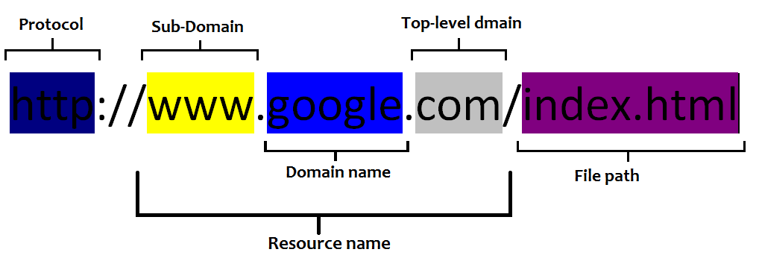
Recall URLs matching

Slide 4
Django templates
Templates are HTML files that have extra syntax
When a view calls render, it passes data into the template, and the template generates the HTML to show the user

Slide 5
Template Syntax
{{ variable }}
A variable's value is shown when the variable name is used inside of double curly braces.
{% tag %}
Template tag is enclosed in curly braces with percent, and are used for for loops, ifs, structrual elements, and other blocks
{{ variable | filter }}
a variable can have a pipe character after it to use a template filter. Template filters take a string as input and return a string as output
can be thought of much like the pipe in shell scripting

Slide 6
Template Variables
#In blog/templates/blog/post_list.html
<h3> {{post.title}} </h3>
#resulting HTML
<h3> The title of the post </h3>

Slide 7
Template Loops
#In blog/templates/blog/post_list.html
{% for post in posts %}
<li> {{ post.title }} </li>
{% endfor %}
#resulting HTML
<li> The title of post 1 </li>
<li> The title of post 2 </li>
<li> The title of post 3he is required </li>
Notice: The posts variable is passed into the template by a view

Slide 8
URL Tag
#In blog/urls.py
urlpatterns = [
url(r'^$', views.post_list, name='post_list'),
url(r'^post/(?P<pk>\d+)/$', views.post_detail, name='post_detail'),
]
{% url ‘post_list’ %} # will generate the path to the post_list view, which is just a slash.
/
{% url ‘post_detail’ post.pk %} # will generate the path to the post_detail view, view for whatever post pk (Id) is given
/post/3/
the URL tag accomplishes is a bit of future-proofing. If we decide to change a URL pattern later on, the links we use in our templates will still be correct if we use the URL tag.

Slide 9
Template Filters
#In blog/templates/blog/post_list.html
<h3> {{post.title|upper}} </h3>
This displays the value of the {{ post.title }} variable after being filtered through the upper filter, which converts text to upper case.
#resulting HTML
<h3>THE TITLE OF THE POST</h3>

Slide 10
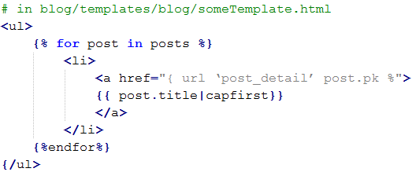
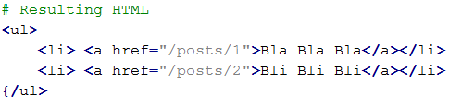
Example
Notes:
# in blog/templates/blog/someTemplate.html
<ul>
{% for post in posts %}
<li>
<a href="{ url ‘post_detail’ post.pk %">
{{ post.title|capfirst}}
</a>
</li>
{%endfor%}
{/ul>
<ul>
<li> <a href="/posts/1">Bla Bla Bla</a></li>
<li> <a href="/posts/2">Bli Bli Bli</a></li>
{/ul>

